Slide 1
HAR
(Human Activity Recognition)

Slide 2

(C01 – C09)

Slide 3
Dataset Description
Number of attributes:
3 (X, Y, Z) - Accelerometer
3 (X, Y, Z) – Gyroscope
Missing attribute values:
None
Sampling Rate :
100 Hz

Slide 4
Sample_Train.csv
Acc_X | Acc_Y | Acc_Z | Gyro_X | Gyro_Y | Gyro_Z
0.58507 | 0.958694 | -0.91408 | 0.508786 | 0.003394 | 0.024296
0.554663 | 1.122004 | -0.84205 | 0.543408 | 0.002409 | 0.034015
0.527227 | 1.208196 | -0.75273 | 0.531366 | -0.00668 | 0.071343
… | … | … | … | … | …
… | … | … | … | … | …
… | … | … | … | … | …
3000 Rows ++

Slide 5
Sample_Test.csv
Acc_X | Acc_Y | Acc_Z | Gyro_X | Gyro_Y | Gyro_Z
0.58507 | 0.958694 | -0.91408 | 0.508786 | 0.003394 | 0.024296
0.554663 | 1.122004 | -0.84205 | 0.543408 | 0.002409 | 0.034015
0.527227 | 1.208196 | -0.75273 | 0.531366 | -0.00668 | 0.071343
… | … | … | … | … | …
… | … | … | … | … | …
… | … | … | … | … | …
500 Rows

Slide 6
EDA

Slide 7
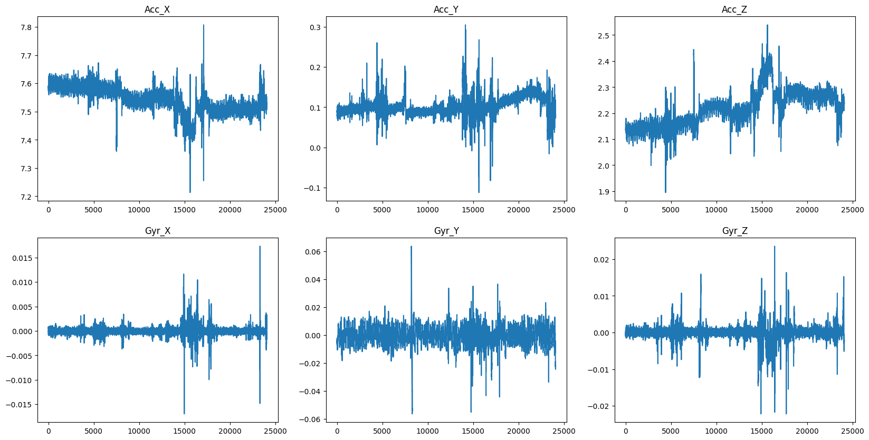
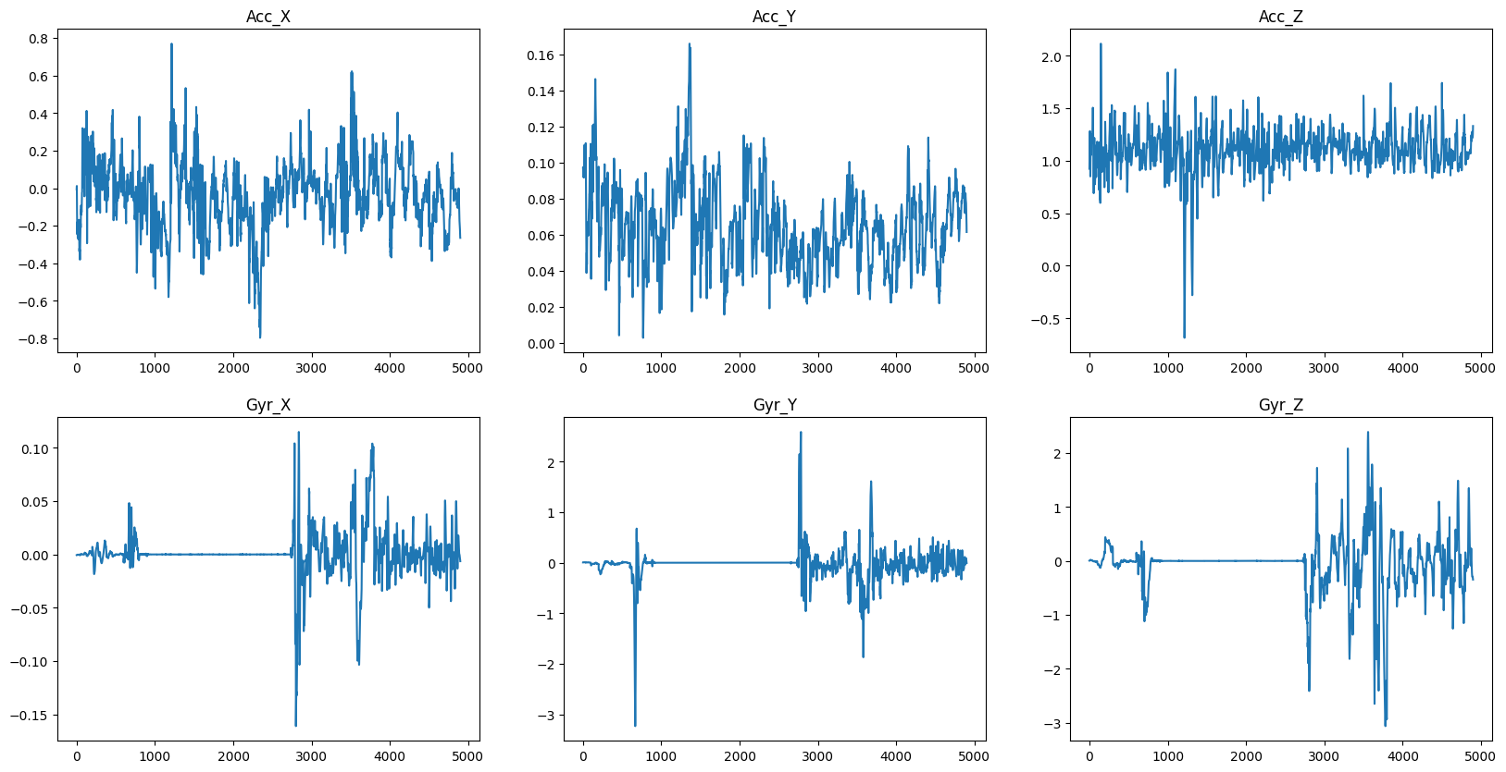
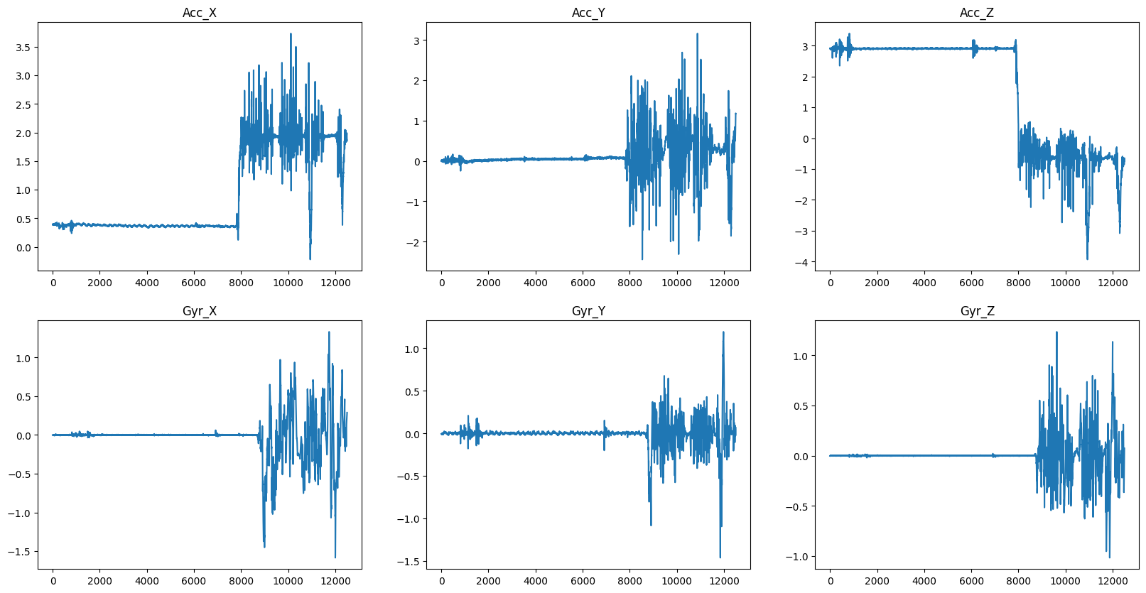
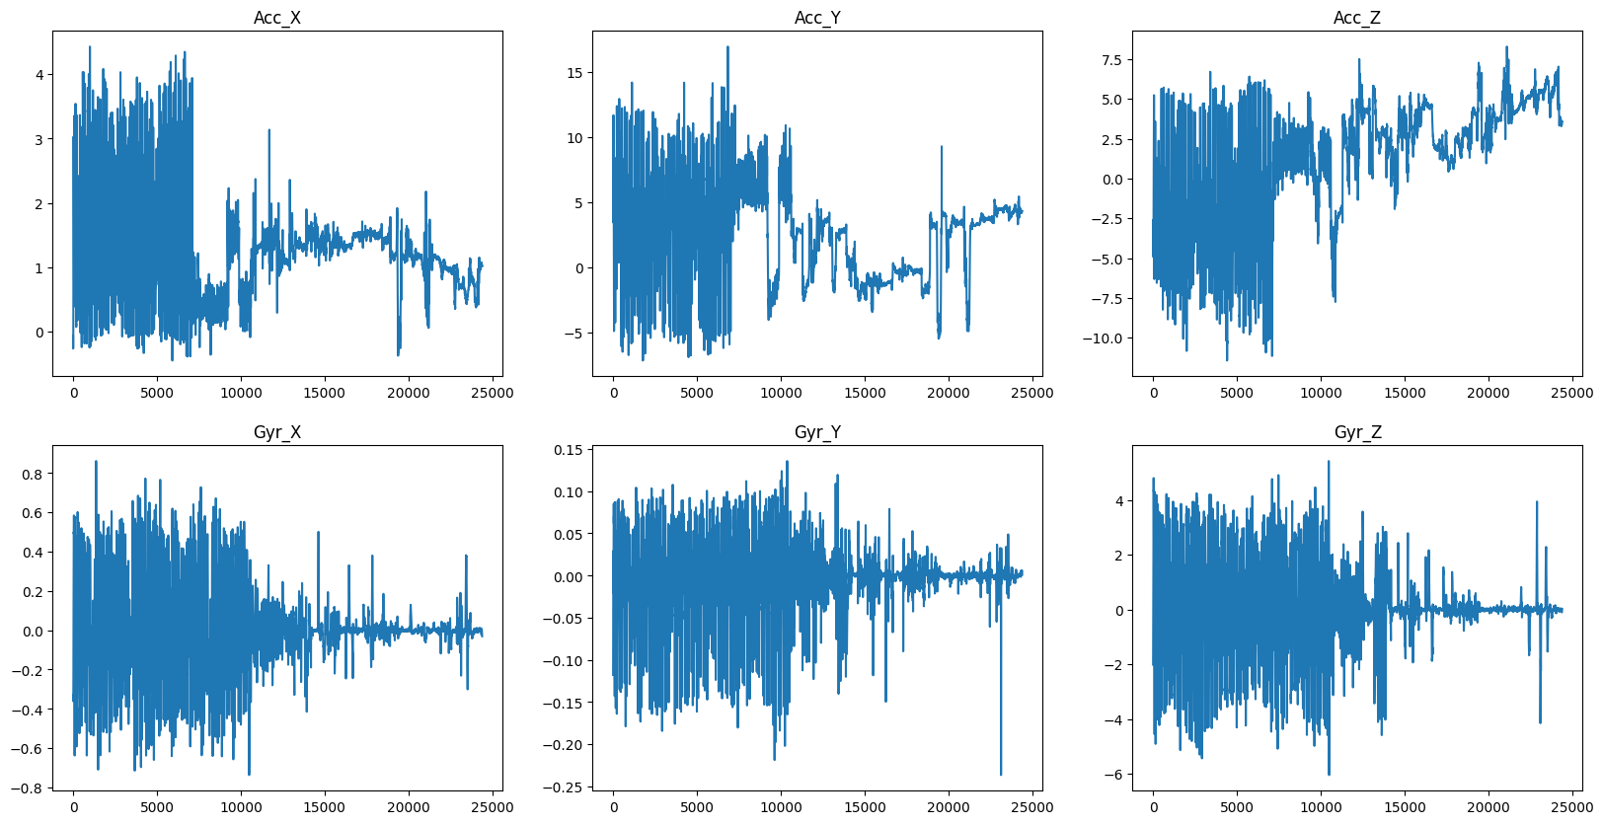
C02
C01
C03
C04

Slide 8
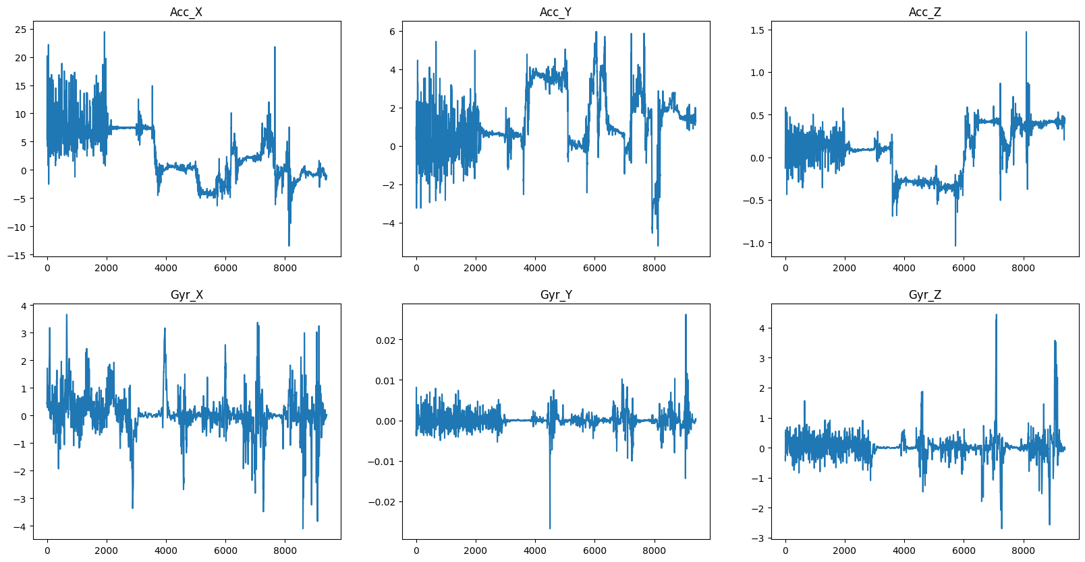
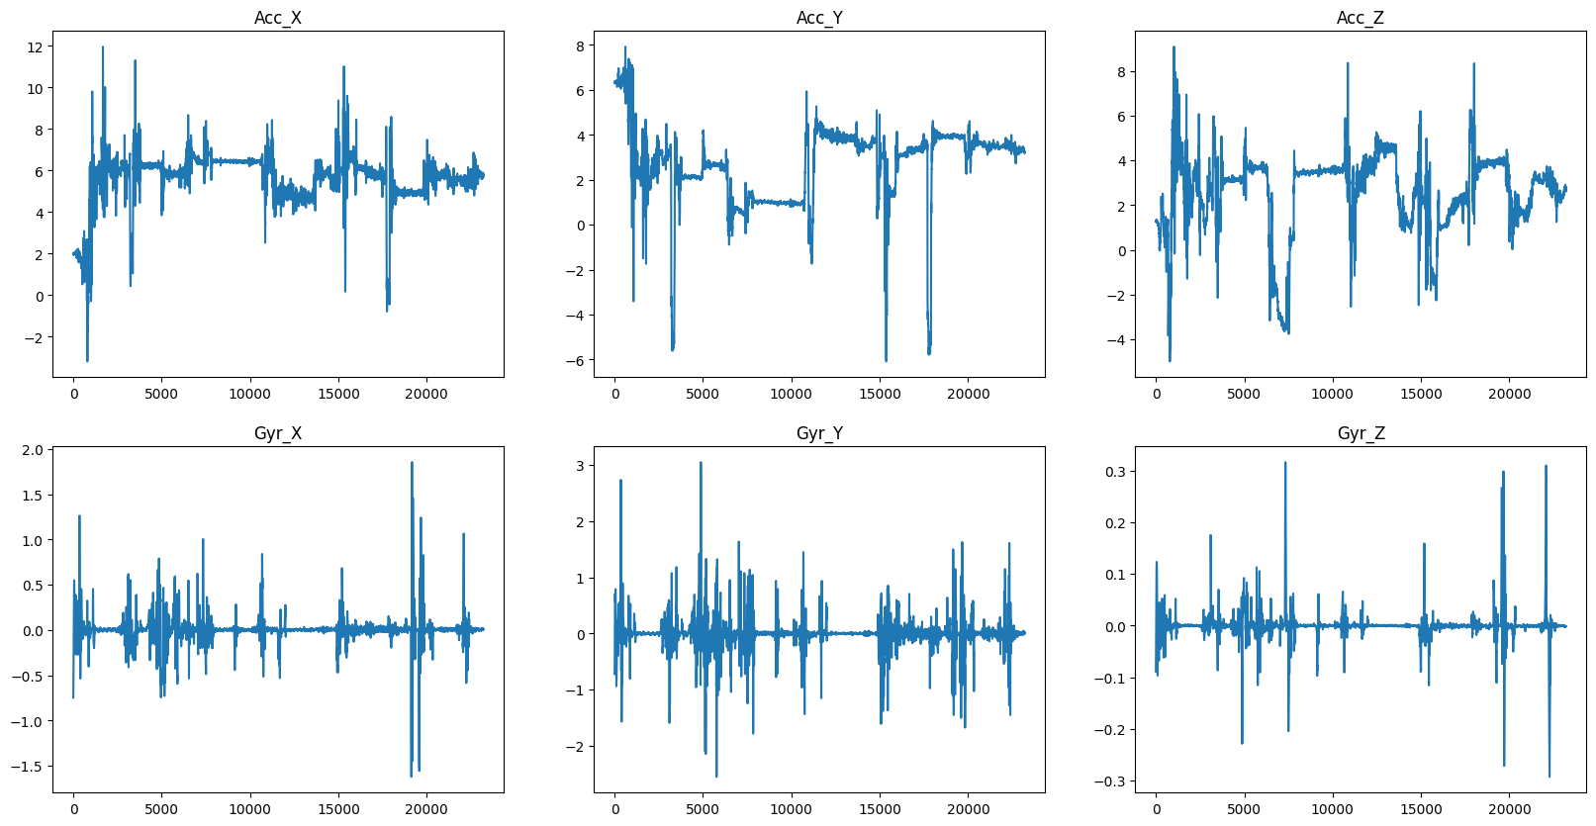
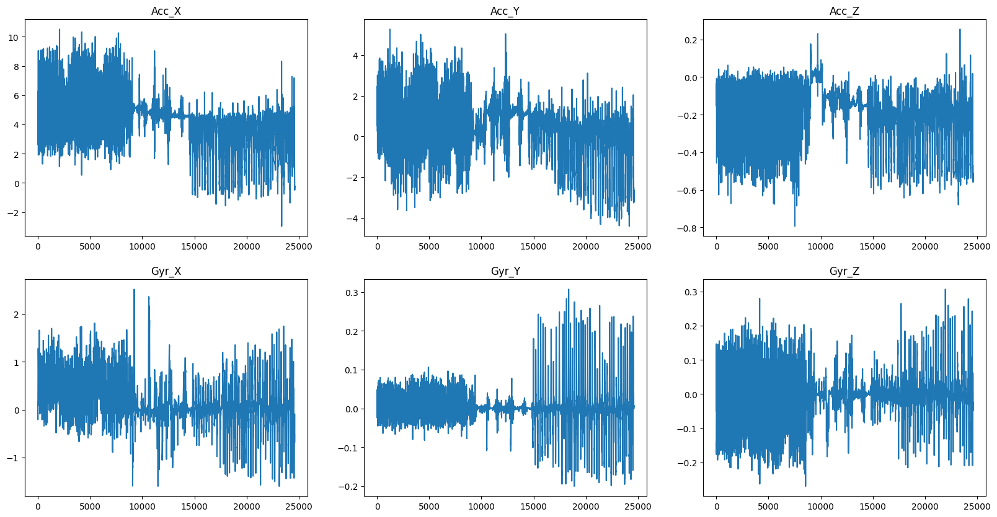
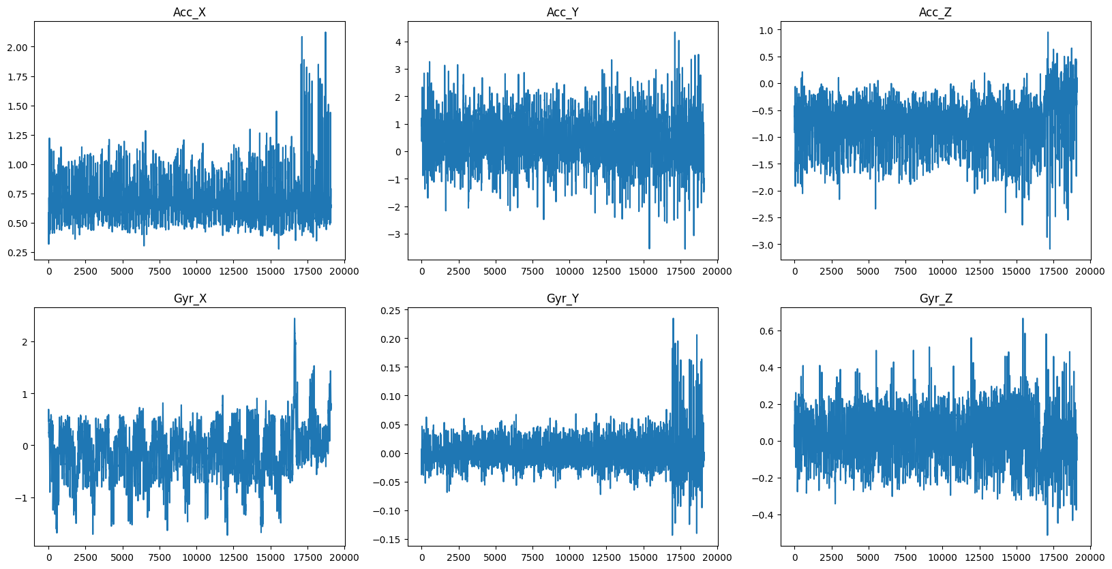
C06
C05
C07
C08

Slide 9
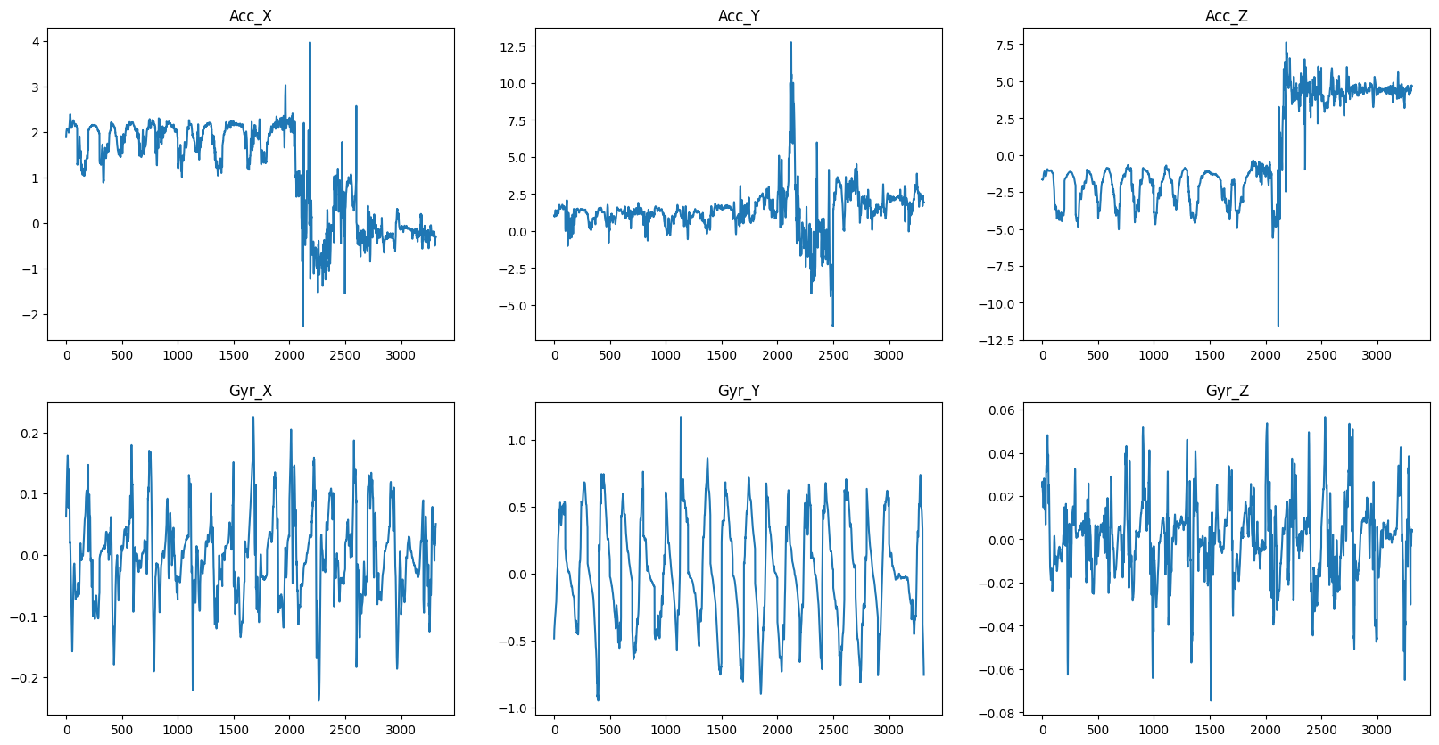
C09

Slide 10
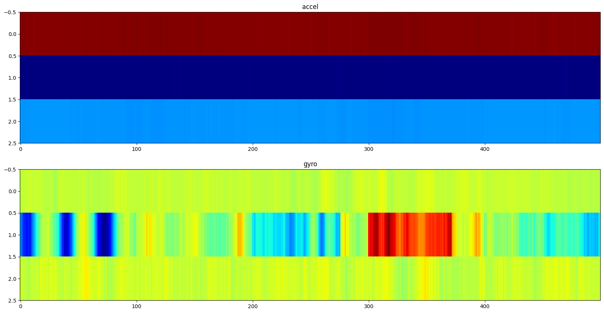
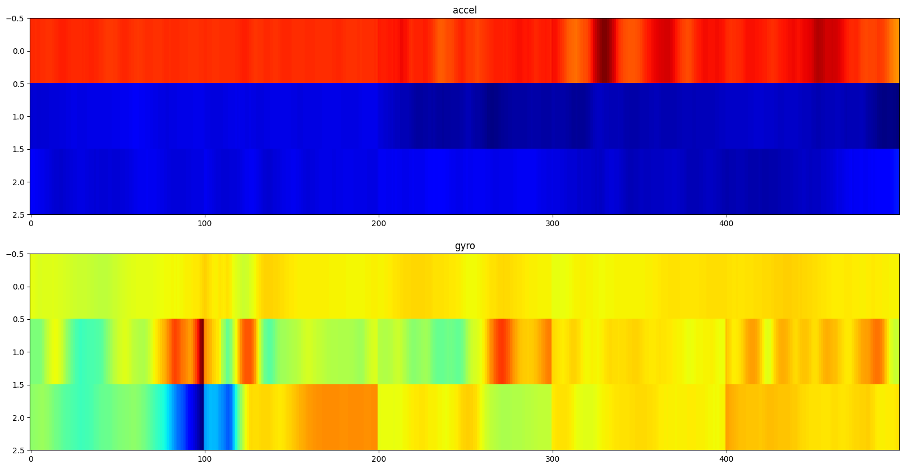
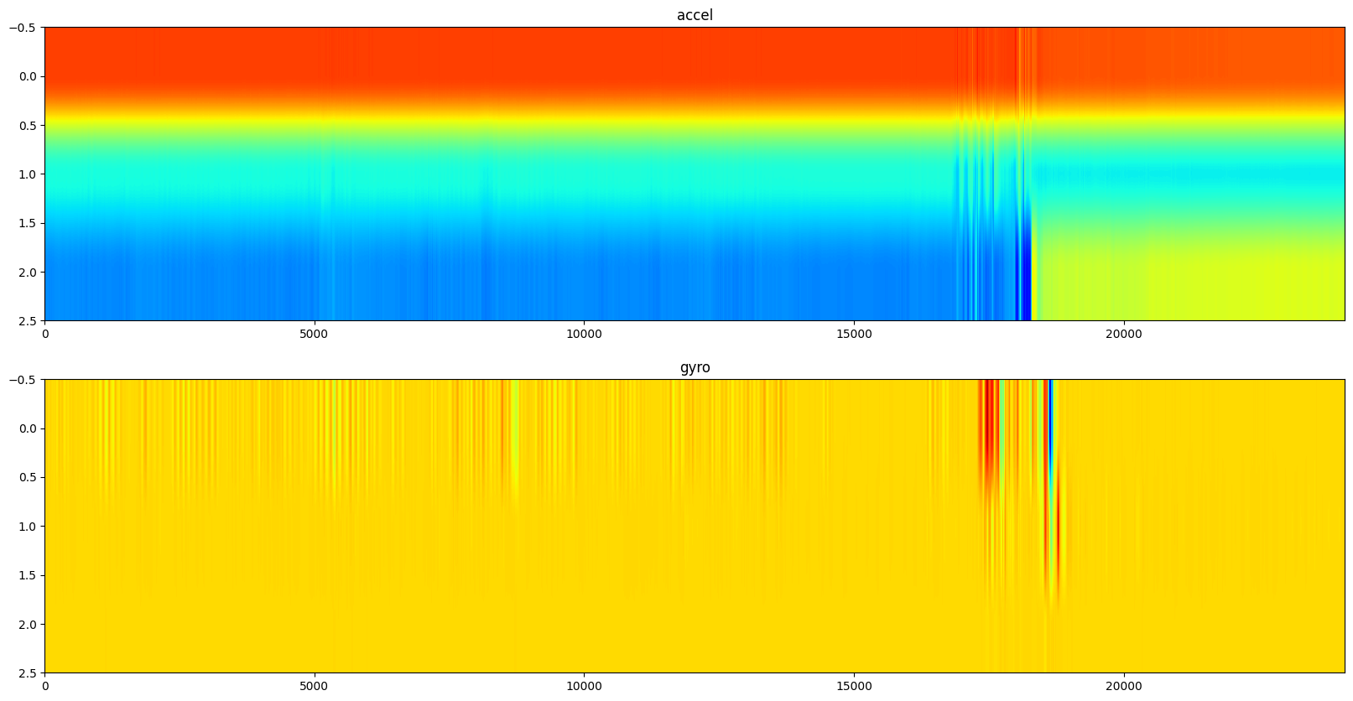
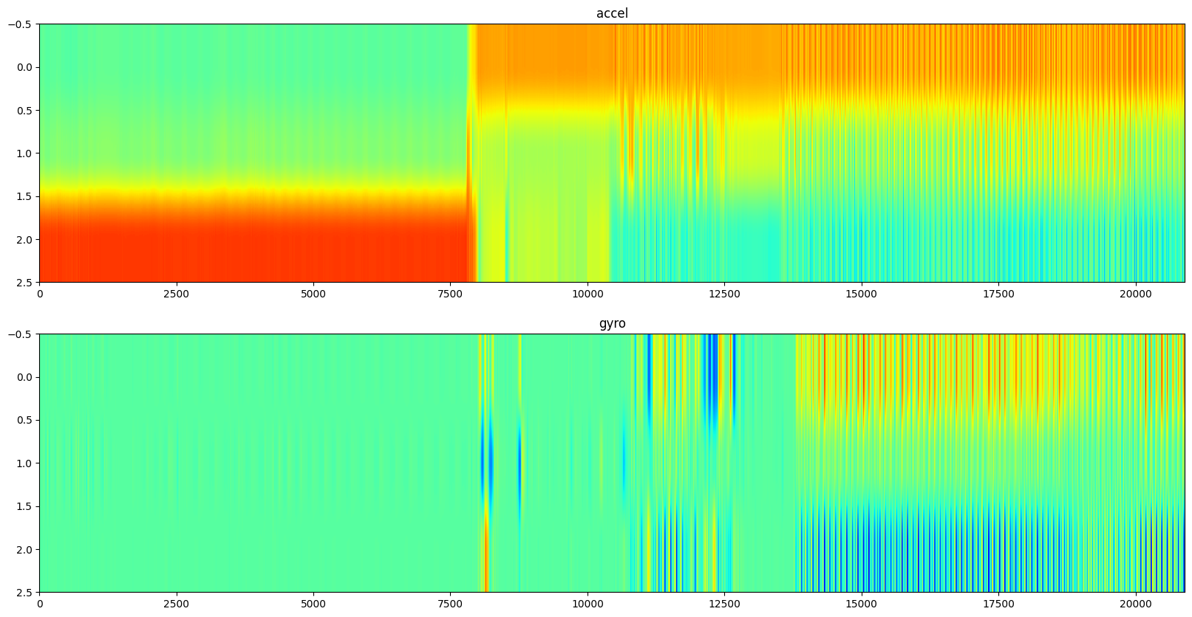

Slide 11
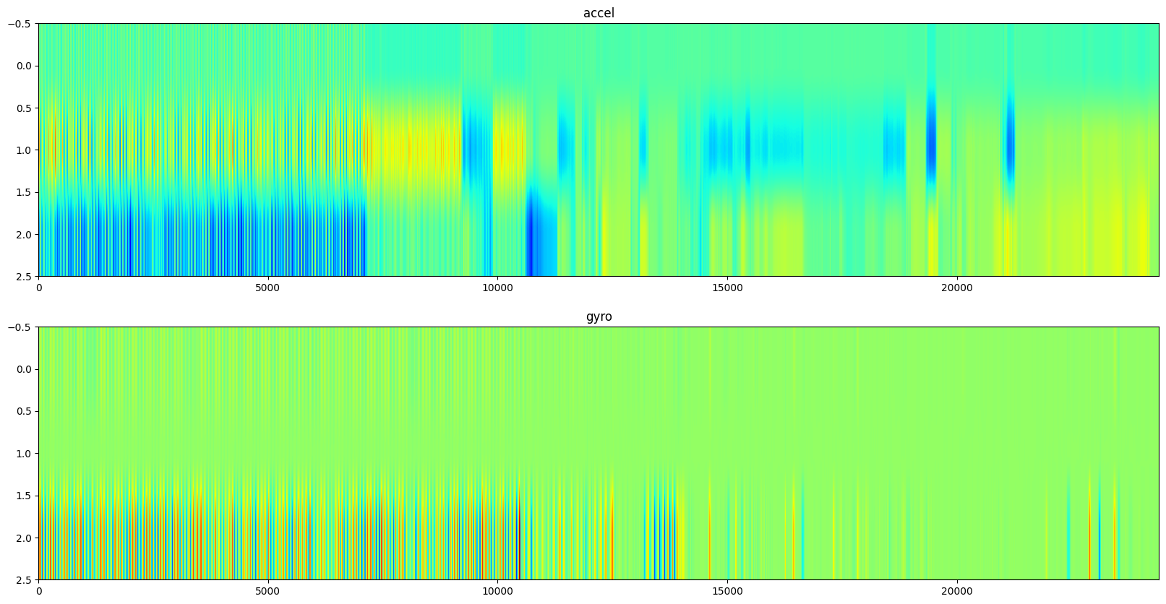
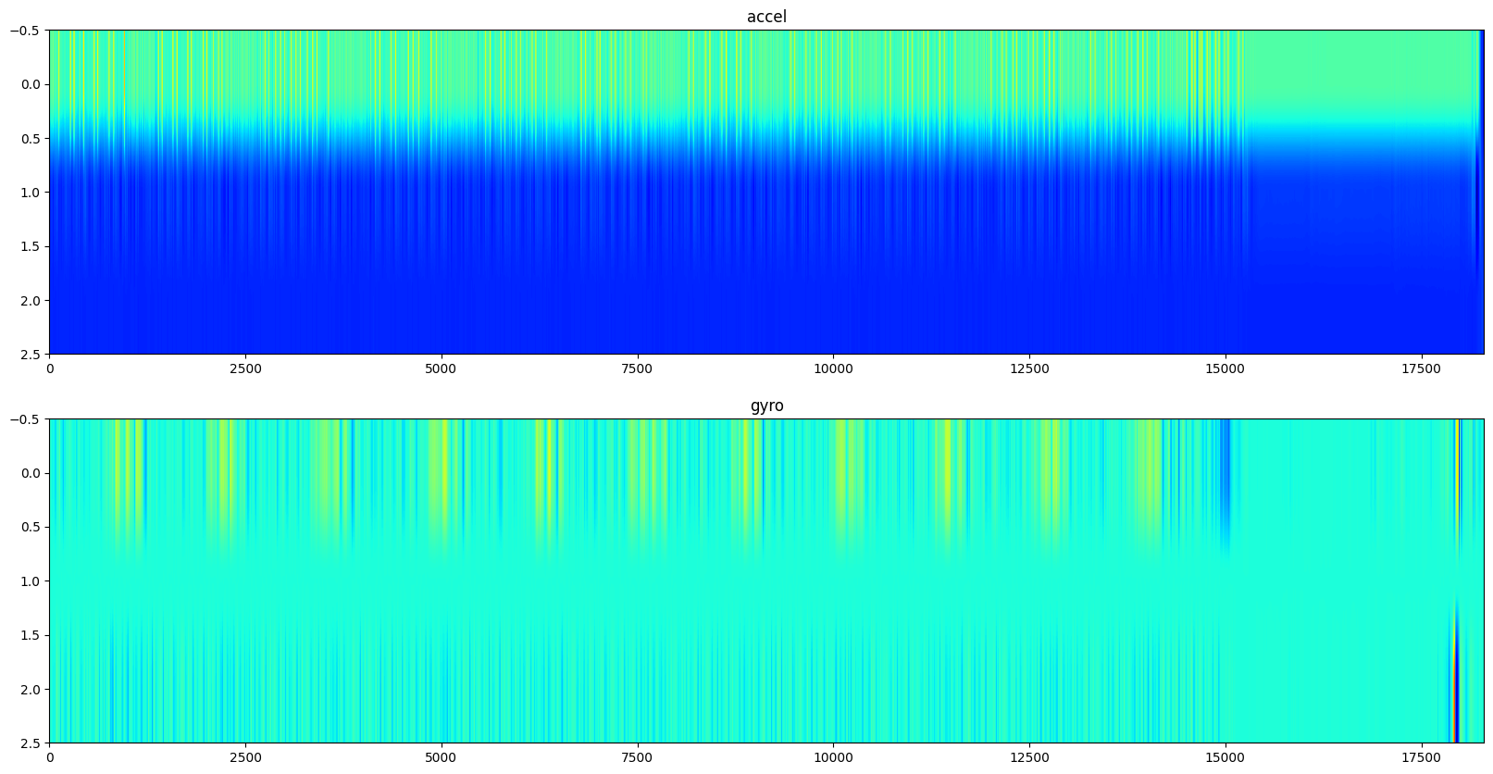
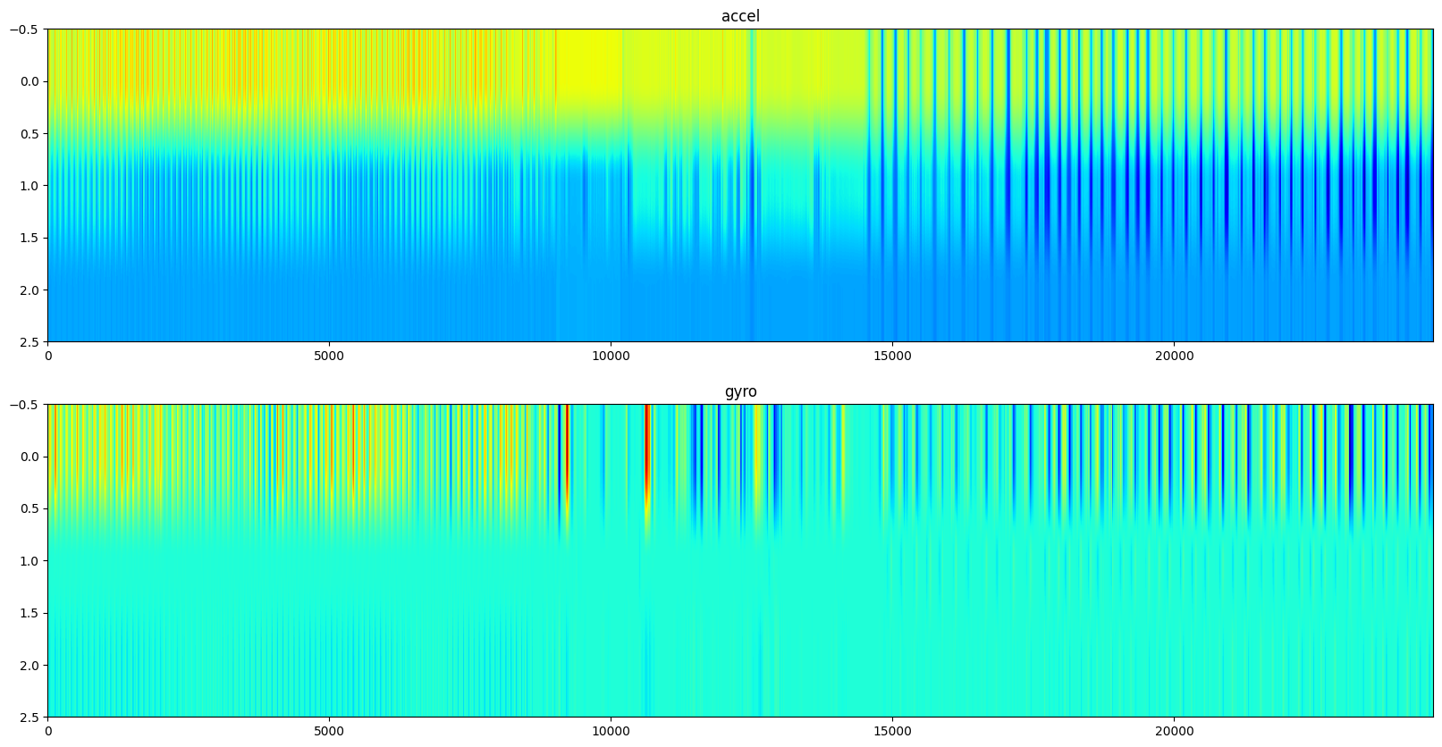
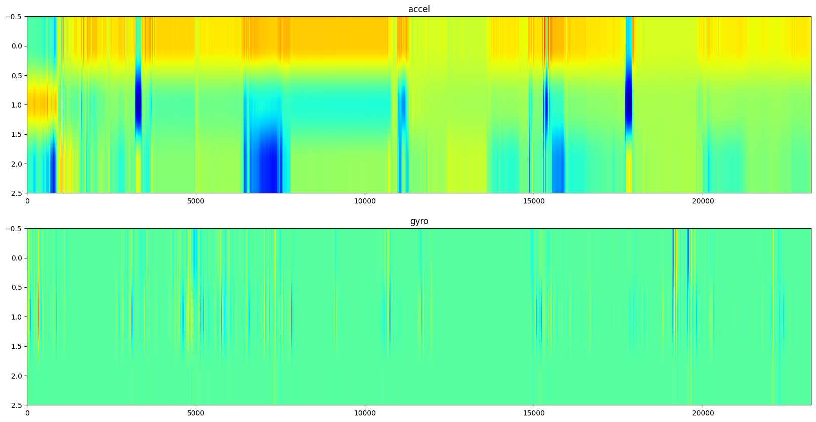

Slide 12
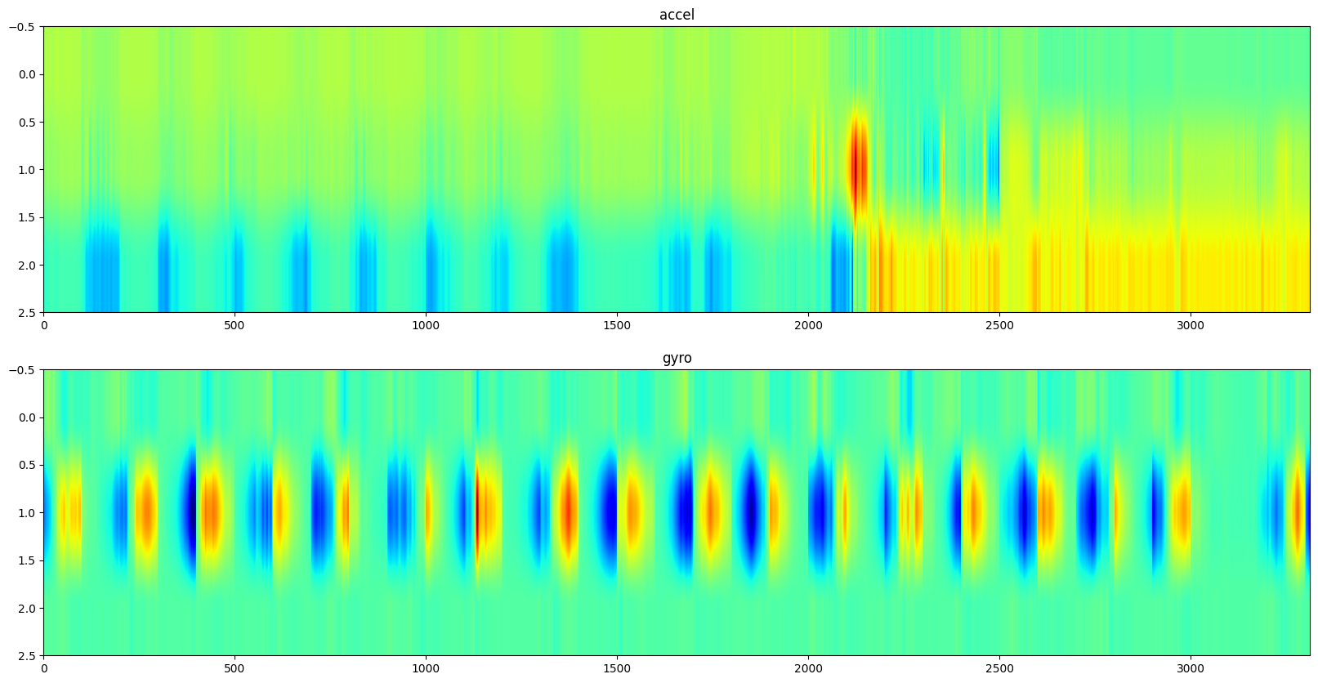

Slide 13
Pipeline #1 Lightgbm+caret experiment

Slide 14
Add Features
Mean
Variance
Lagged+Downsample
Multiple predictions per cell

Slide 15
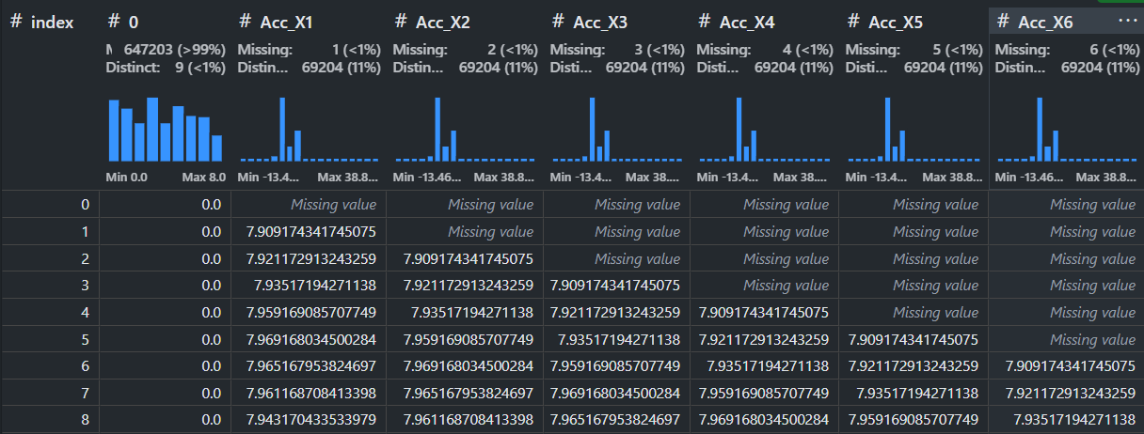
Lagged Features

Slide 17
Confusion Matrix
C01
C02
C03
C04
C05
C06
C07
C08
C09
C01
C02
C03
C04
Predictions
C05
C06
C07
C08
C09
Targets

Slide 18
C03
C09

Slide 19
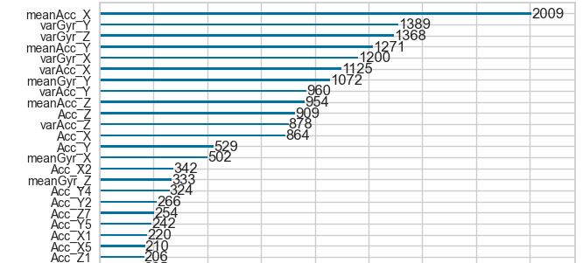
Feature Importance

Slide 20
C06
C07

Slide 21
Pipeline#2
LightGBM / Catboost

Slide 22
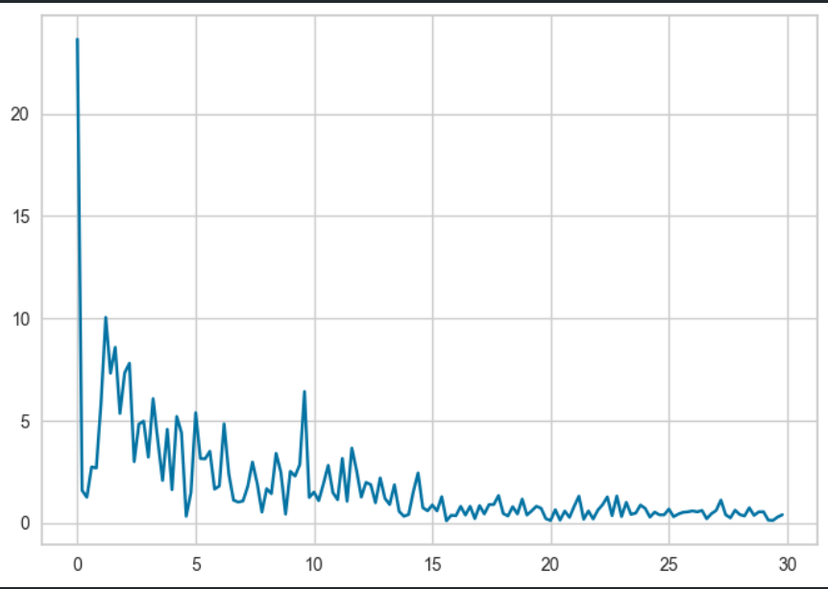
Add Features
Fourier Transform
Kurtosis/Skew
Stratified 5-Fold

Slide 23
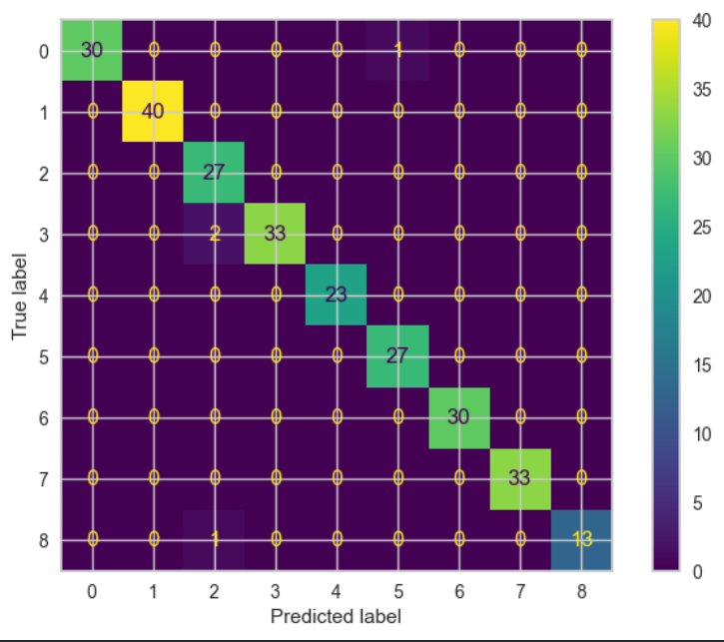
Confusion Matrix

Slide 24
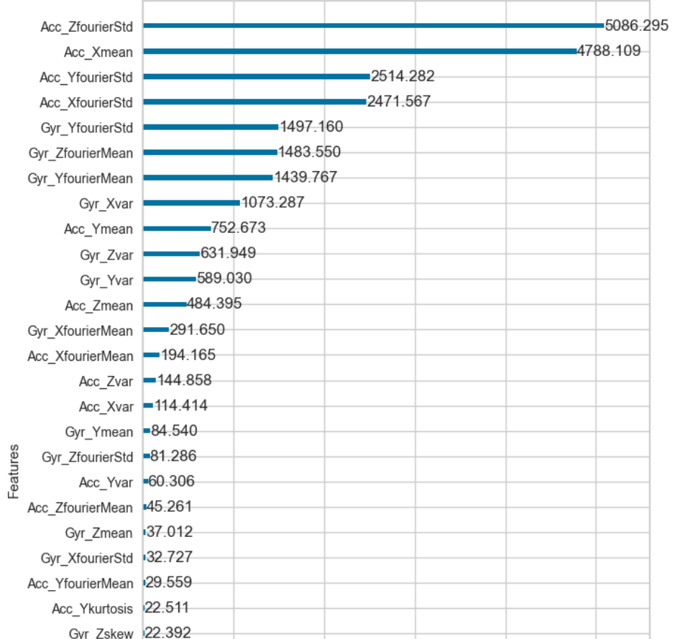
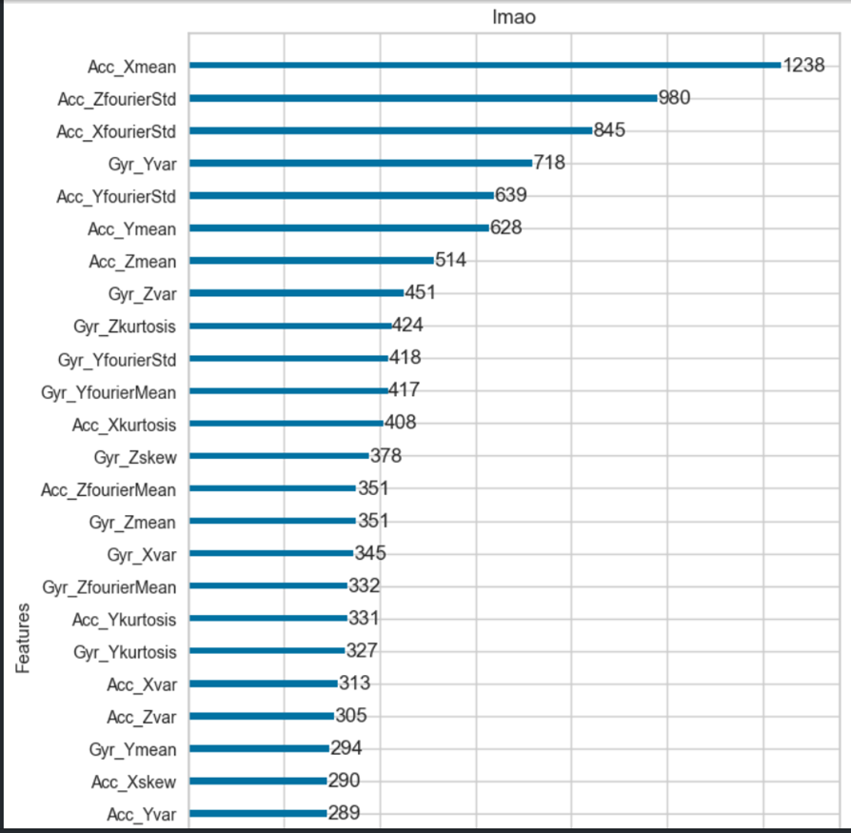
Feature Importance(gain/split)

Slide 25
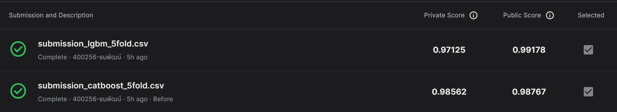
Results: inference time 1+0.8 second

Slide 26
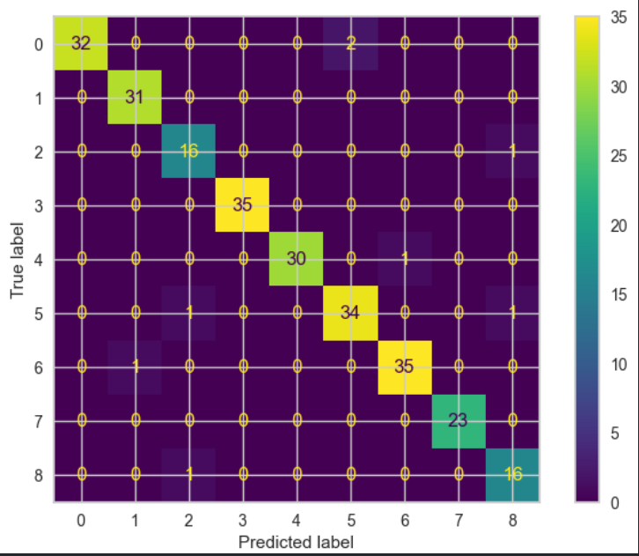
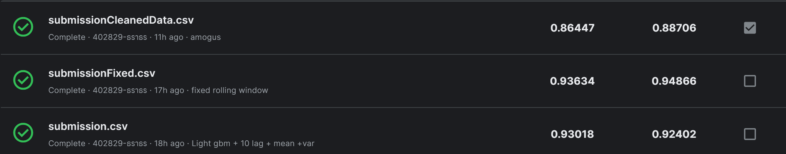
Same confusion matrix?

Slide 27
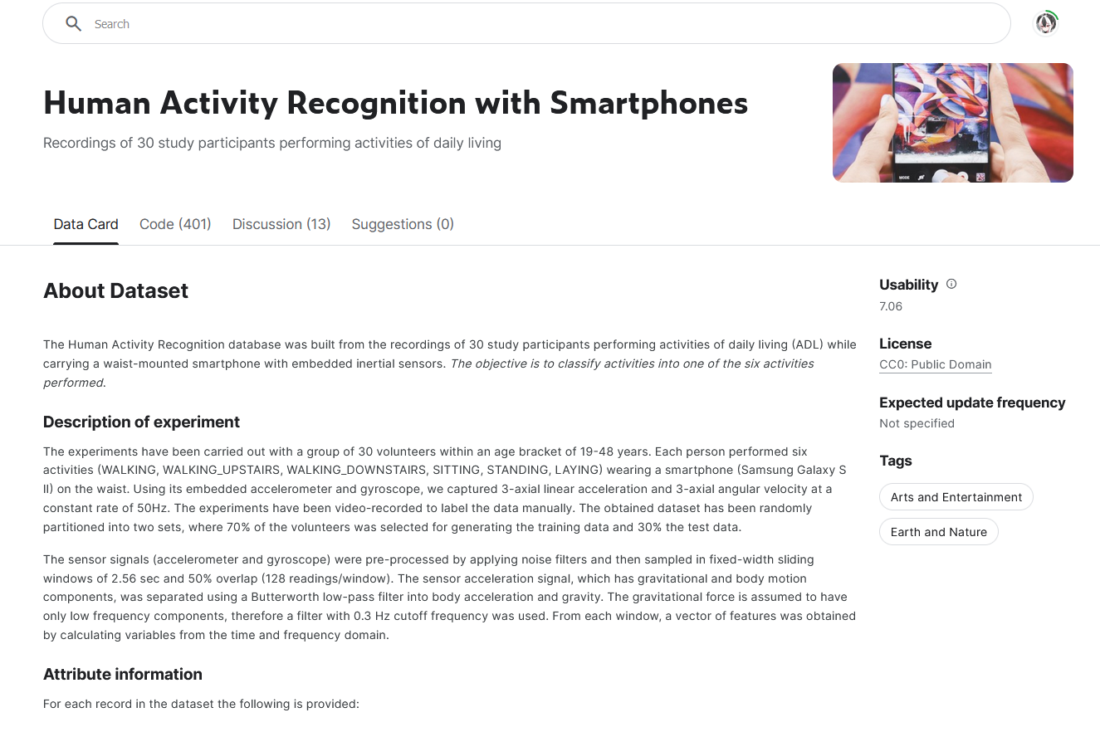
Future plans
Data oversampling
Training on
extra datasets

Slide 28
Future plans
More visualization (Sankey-diagram)
More Feature engineering(entropy, PSD, energy, jerk, Freq. binning)
Optuna implementation
Experiment with filters
Experiment with ViTs

Slide 29
Q & A

